Slide 1
What is Radioactivity?

Slide 2
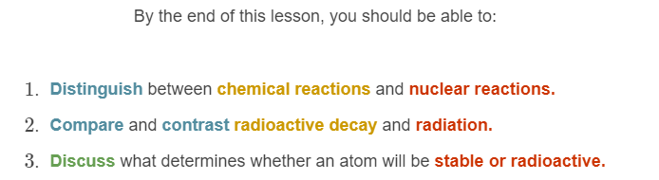
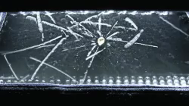

Slide 3

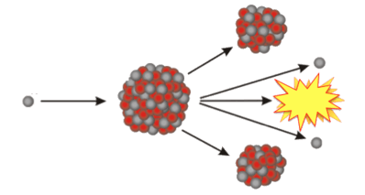
Chemical reactions vs. nuclear reactions:
Chemical reactions are reactions you can see happening around you all the time, like when you leave your bike out in the rain and it starts to rust. These reactions involve a change in the arrangement of electrons in atoms.
Nuclear reactions involve a change in the nucleus of atoms. They are not related to chemical reactions. If the nucleus of an atom changes in a certain way, it can actually change into an atom of a different element!

Slide 4
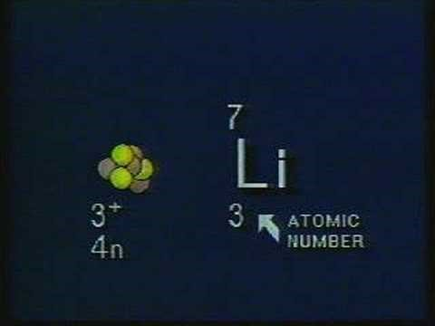

Slide 5


Slide 6
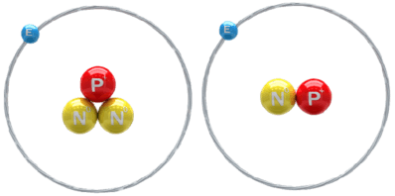
Remember, the identity and chemical properties of an element are determined by the number of protons in its nucleus.
Remember that some elements can have isotopes, which are atoms with the same number of protons but a different number of neutrons.
Both of these atoms have one proton, so they are both hydrogen atoms. However, they have a different number of neutrons, which means they are isotopes.

Slide 7
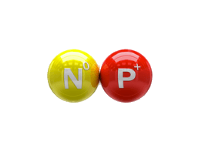
As elements get larger and heavier, so do their nuclei.
The protons in the nucleus need a "nuclear glue" to hold them together, because otherwise the positive charges would repel one another. The neutrons increase the strength of a force called the strong nuclear force, which helps prevent this repulsion between protons.
The larger the atoms get, the stronger the "glue" needs to be, so the more neutrons need to be in the nucleus.

Slide 8
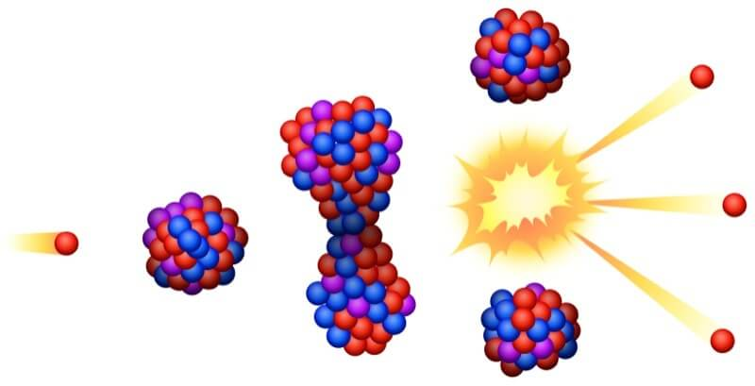
If there are enough neutrons to hold the nucleus together, the atom will be stable.
Sometimes there are either too many protons or too many neutrons in the nucleus, and the atom is unstable.

Slide 9
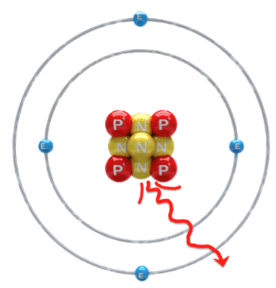
Unstable nuclei try to stabilise themselves by throwing out particles. This process is called radioactive decay, and the particles are known as radiation.
Natural radioactivity is when an atom's nucleus spontaneously breaks down and releases radiation.

Slide 10
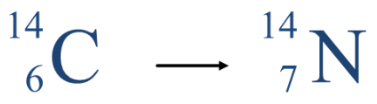
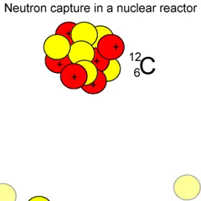
Light elements with low atomic masses are more stable and therefore less radioactive than heavy elements with high atomic masses.
This is because they have fewer protons in the nucleus. A 1:1 ratio of protons to neutrons is needed for light elements to remain stable.
If the nucleus is unstable, it will decay and release radiation. For example, carbon-14 decays into nitrogen-14 at a constant rate.

Slide 11
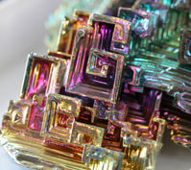

Heavy elements are generally unstable, so are very radioactive.
Heavy elements have lots of protons, so a ratio of 3:2 neutrons to protons is required to stabilise the nucleus.
Elements after bismuth on the periodic table have no stable isotopes, so they all decay spontaneously. This is why there are so few naturally occurring heavy elements.

